Slide 1


Power Query Table Functions Part 2

Slide 2
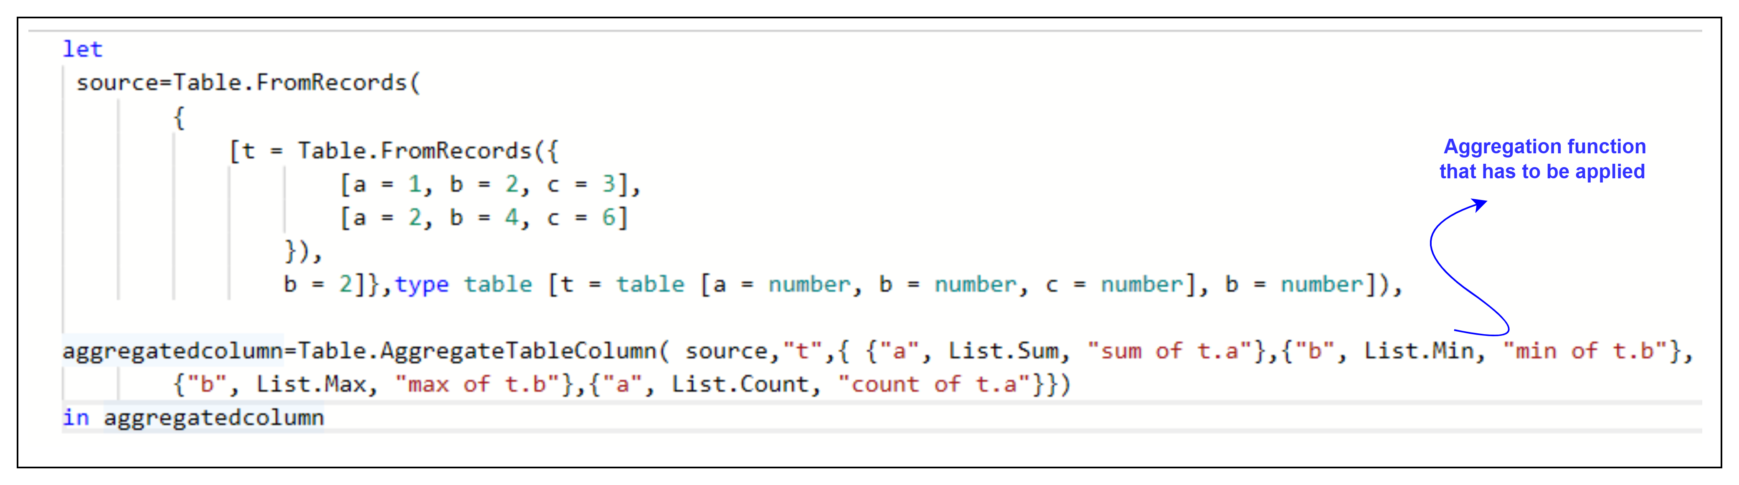
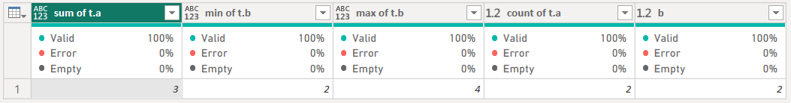
1. Table.AggregateTableColumn
Description: Aggregates tables in table[column] into multiple columns containing aggregate values for the tables.
Example:
Result:
Use Cases:
Summarizing nested tables.
Consolidating detailed data into summary metrics.

Slide 3
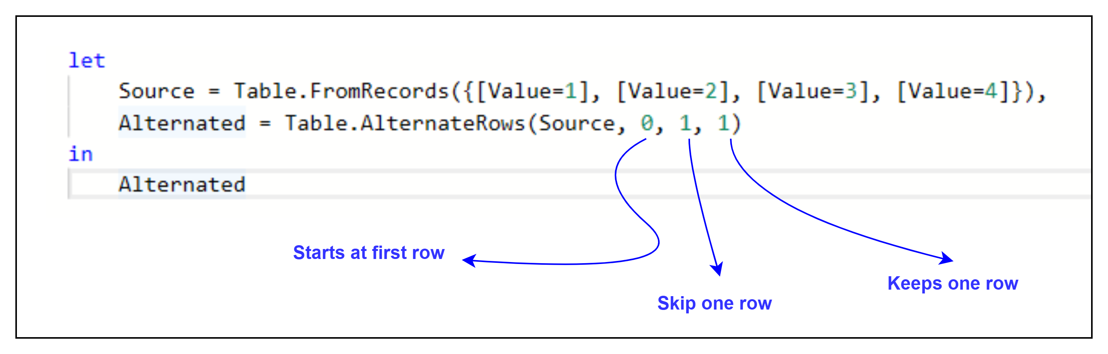
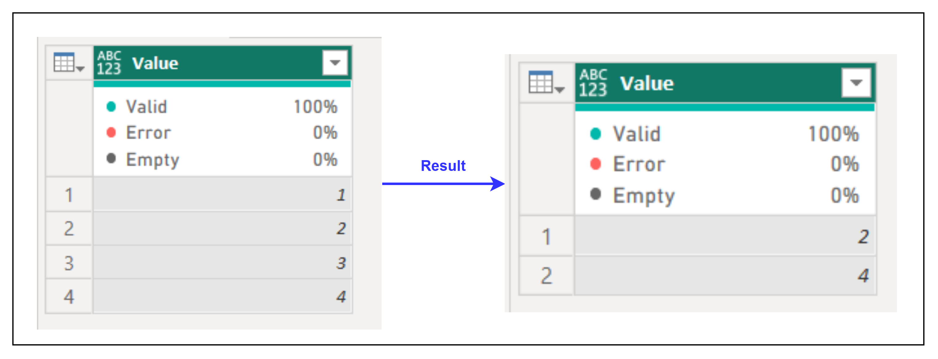
2. Table.AlternateRows
Description: Returns a table with a subset of rows, skipping rows alternately.
Example:
Result:
Use Cases:
Sampling data from a table.
Creating subsets for testing.

Slide 4
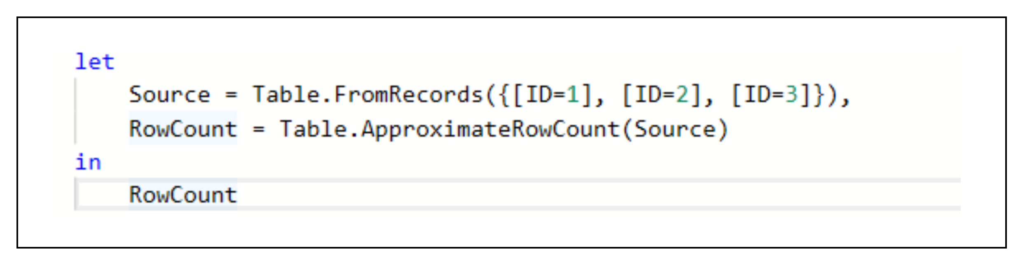
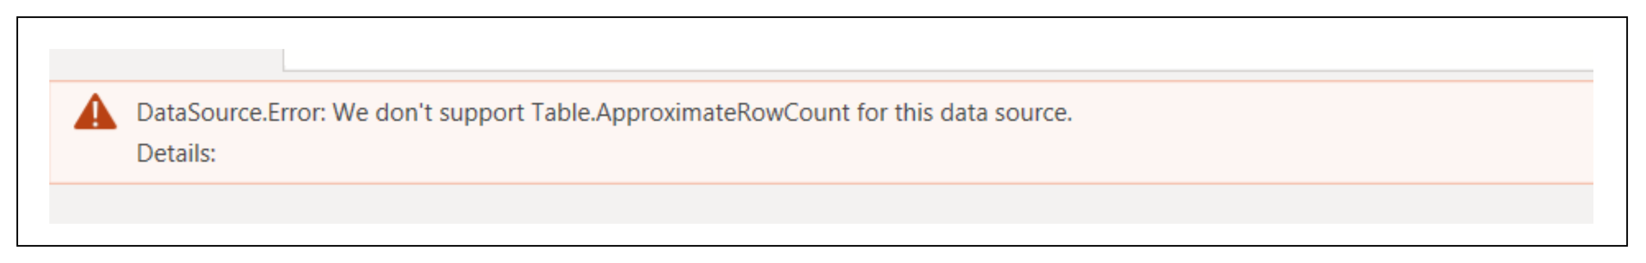
3. Table.ApproximateRowCount
Description: Returns the approximate number of rows in the table, or an error if the data source doesn't support approximation.
Example:
Result:
Use Cases:
Quick row count for large datasets.
Optimizing performance when precision is not necessary.

Slide 5
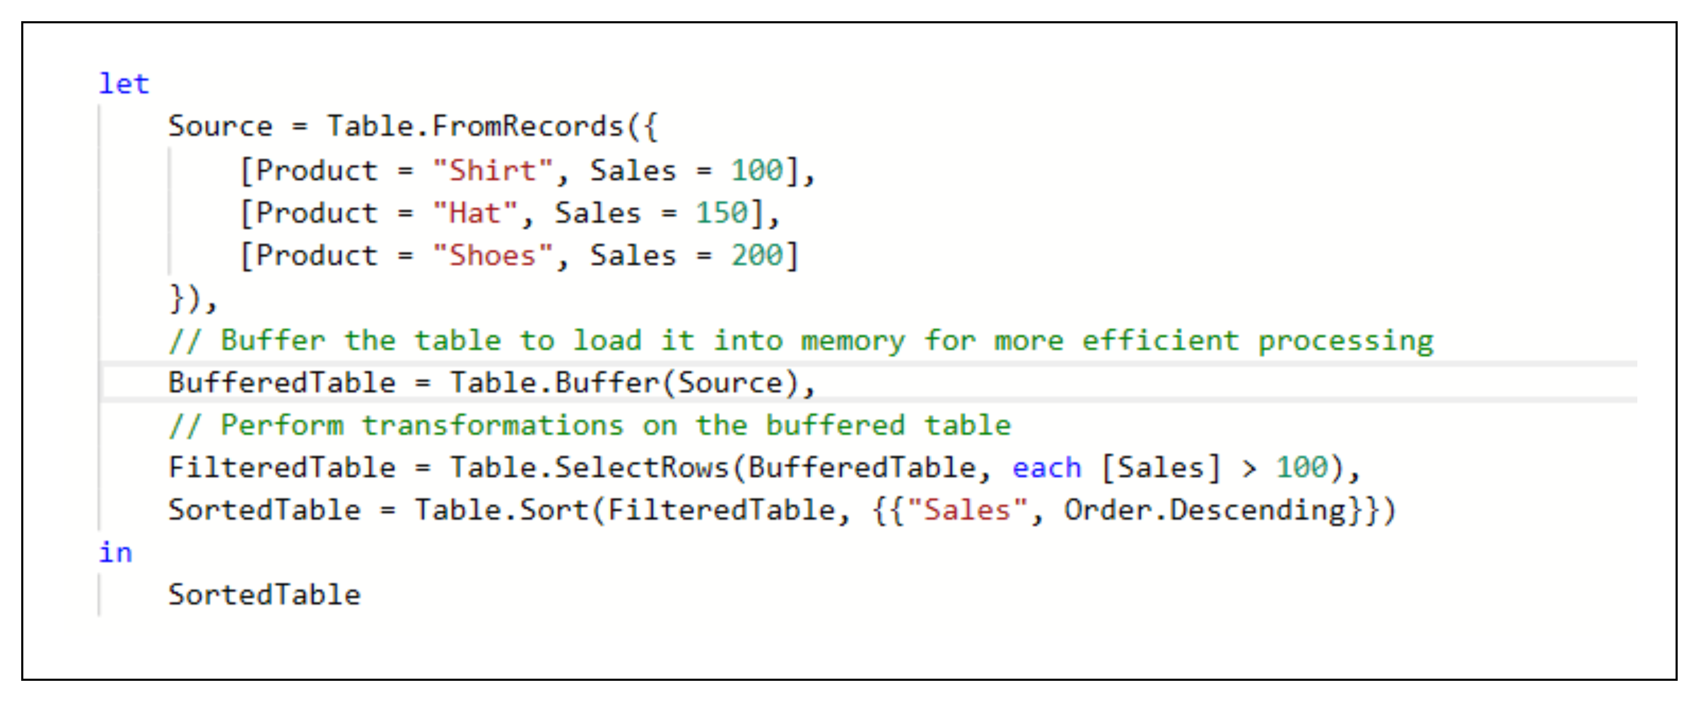
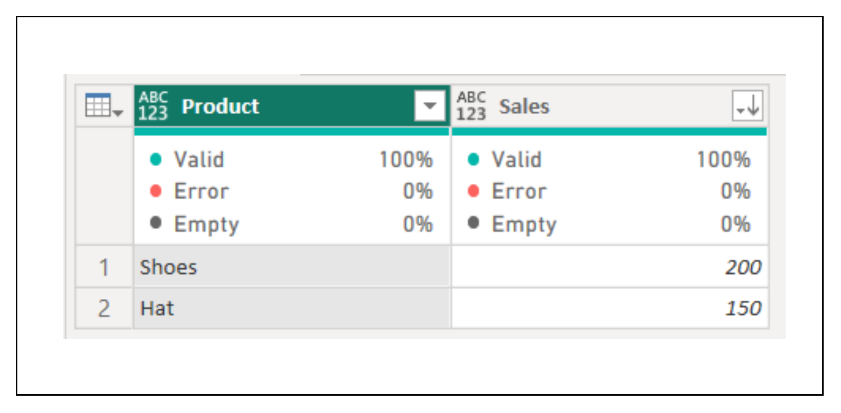
4. Table.Buffer
Description: Loads the table into memory to optimize subsequent transformations.
Example:
Result:
Use Cases:
Improving performance when reusing the same data multiple times.
Avoiding redundant recalculations.

